Slide 1
Intermountain West Data Warehouse
Overview and Data Products
Western U.S. TEMPO Early Adopters Workshop
April 10-11, 2018
Fort Collins, CO

Slide 2
IWDW-WAQS Overview
WAQS (Western Air Quality Study)
State-of-the-art air quality modeling products to support studies assessing air quality in the intermountain west region
IWDW (Intermountain West Data Warehouse)
Access to air quality monitoring data & air quality modeling platforms
Project oversight and data request UI and tracking
Online data visualization and evaluation tools
Monitoring Data
Standard EPA networks (IMPROVE, NPS, AQS, CASTNet, NADP), Special Studies, RPOs & Local Agencies)
Visibility, ozone and deposition summaries
Modeling Platforms
WAQS sponsored PGM modeling
WAQS derivative modeling studies
Externally produced modeling platforms
Applications
NEPA modeling studies (targeted for O&G development projects)
SIP modeling for O3, PM and haze planning
Research
Internal Analysis
Monitoring Network Assessment
Boundary conditions, winter meteorology and winter O3, source apportionment

Slide 3
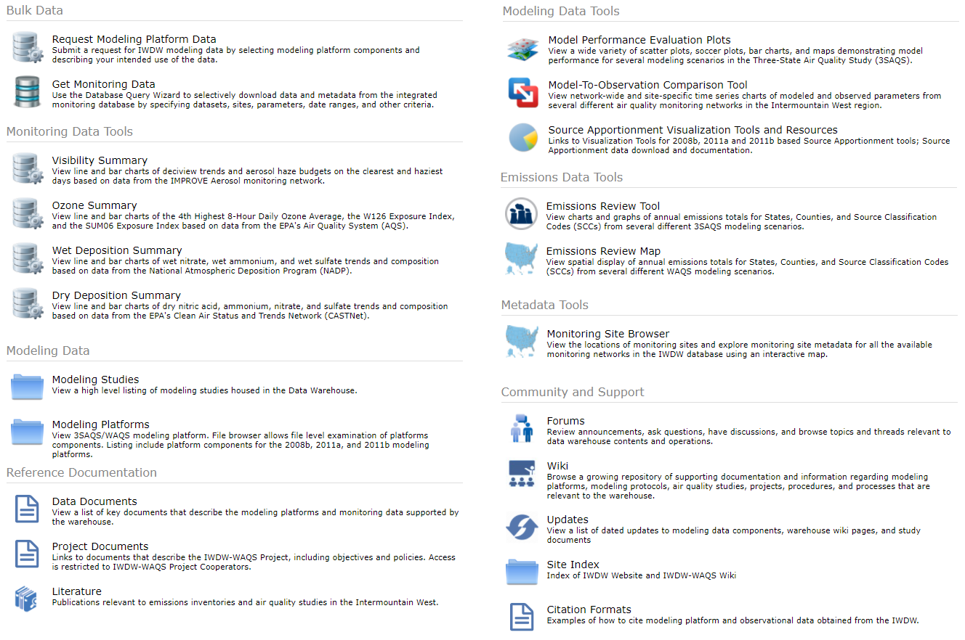
Data, Tools and Resources

Slide 4
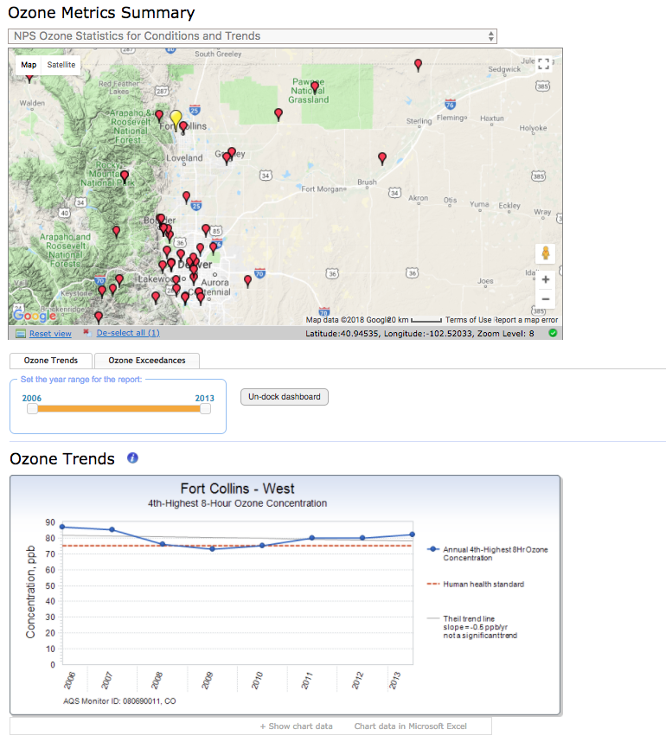
Monitoring Data
Air Quality Monitoring Data
Monitoring site metadata
Raw data from AQS and other sources
Data products
Relevance to TEMPO
Monitor locations, sampling frequency
Ground level concentration validation

Slide 5
Air Quality Modeling
Modeling Platform: All data and software tools associated with a photochemical grid modeling (PGM) project
Scripts and software
PGM Input Data
Meteorology
Unprocessed and model-ready emissions
Initial/boundary conditions
Ancillary data
PGM Output Data
Concentrations
Deposition
Visibility metrics
Model-obs pairs
Special Study Data
Initial Conditions
Restart
Meteorology
PGM
Emissions
Nesting
Boundary Conditions
Notes:
Special Study Data = source apportionment, attainment test, unmonitored area analysis, MPE plots

Slide 6
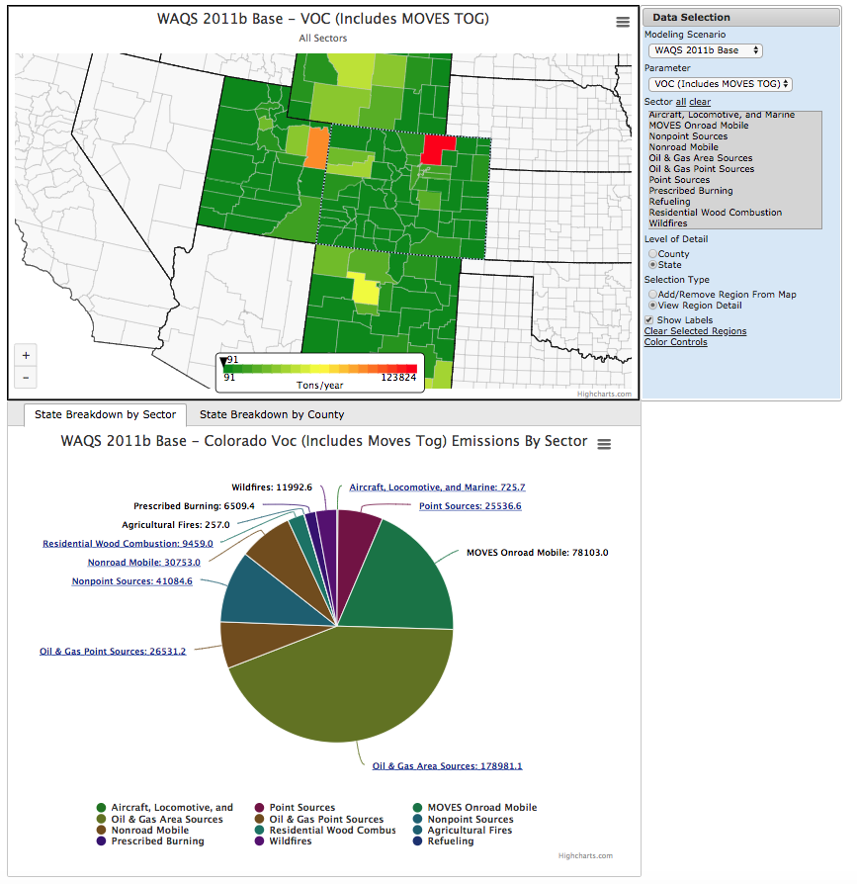
Air Quality Modeling
Emissions
Online tools show processed county level emissions by chemical species and source sector
Includes area and point sources
Displays for gridded ‘model-ready’ emissions also available
Relevance to TEMPO
Address discrepancies between top-down and bottom-up emissions inventories
Inform development of ancillary data for PGM

Slide 7
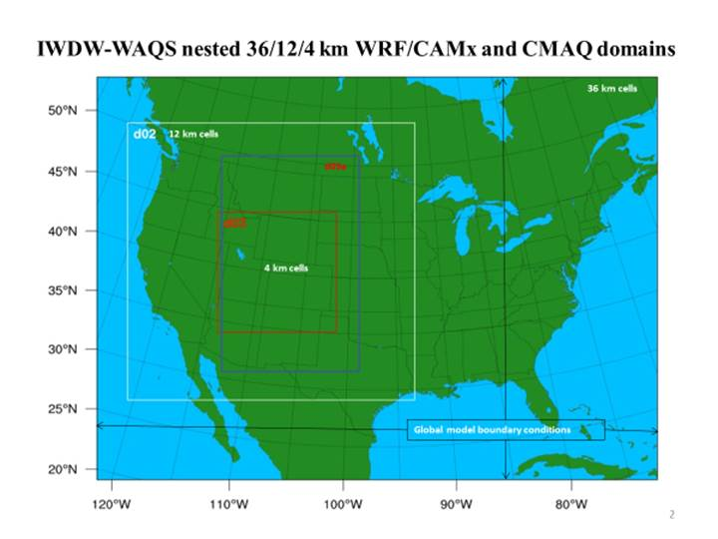
Air Quality Modeling
WAQS Modeling Platforms
WRF meteorology data
SMOKE-processed emissions: NEI + regional oil and gas + regional natural (fires, biogenic, lightning)
WAQS Photochemical Grid Modeling
2008: 36/12km CAMx simulation with a 2020 future year
2011: 36/12/4km CMAQ and CAMx simulations with a 2025 future year
Sensitivity study data by request
2014: in progress
Notes:
WAQS Modeling Platforms
What are they and how are they used by the IWDW
What is a modeling platform’s intended use
WAQS simulations (2008, 2011a, 2011b, future years, CMAQ+CAMx, WRF, SMOKE)
2011b updates

Slide 8
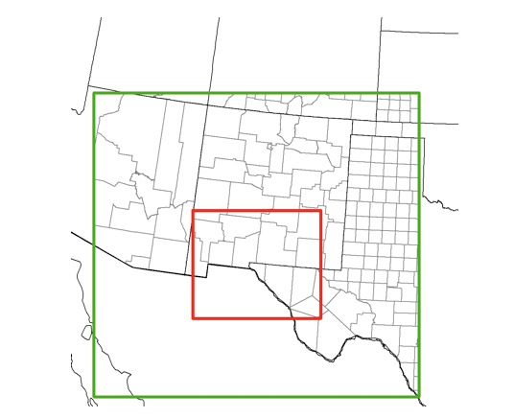
Air Quality Modeling
External Modeling Platforms
WestJumpAQMS (2008, archive)
CARMMS (v1.0, 2011 Base Case, 2021 Planning)
SNMOS (2011 Base Case, 2025 Planning with SA Tools)
Denver/NFR O3 SIP (2011 Base Case, 2017 Planning w/ SA Tools)
EPA national air quality transport analysis
2011v3 base case
2023 ozone transport
2028 Regional Haze contribution
analysis (pending)
EPA national WRF/MMIF for AERMOD
(2013, 2014, 2015)
2016 Collaborative (2014, 2015, 2016)
12km CONUS
SNMOS 12/4-km Modeling Domains

Slide 9
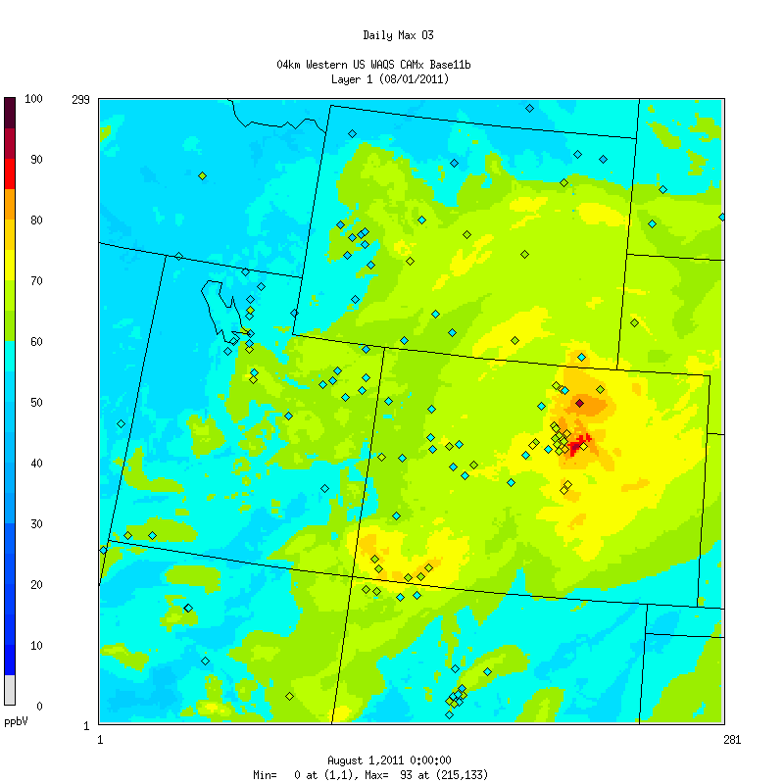
Air Quality Modeling
Modeling Data Tools
Data visualization
Model performance evaluation (AMET) ‘model-to-obs’
Source apportionment
Data request UI and file server
Relevance to TEMPO
Leverage gridded data display tools
Comparisons to Observations

Slide 10
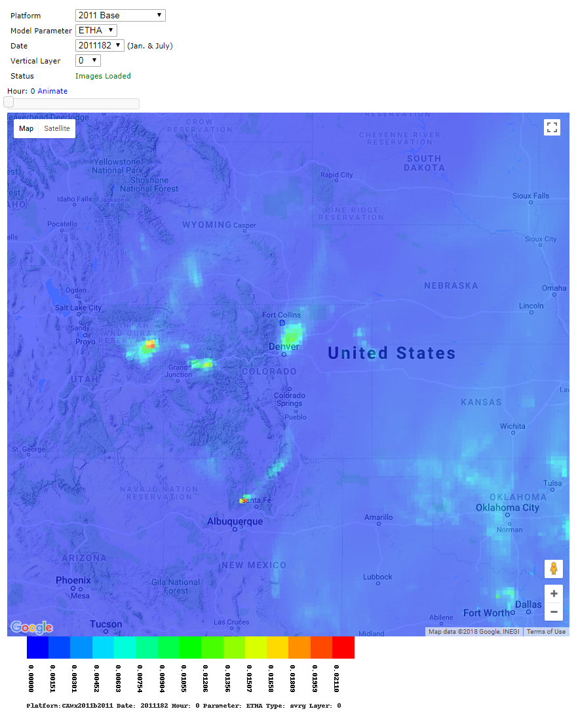
Air Quality Modeling
Modeling Data Tools
On-line displays of gridded data (example shows WAQS 2011b CAMx 12km, July 1 hr 0, ground level ethane)
Hot-spots show fires and O&G development basins
Additional Displays
gridded met., emissions
raw & processed PGM (e.g. column totals)
PGM results matched to AQ observations
regulatory AQ metrics (e.g. 4th highest 8-hr O3, 12-hr NO2 preceding 8-hr O3)

Slide 11
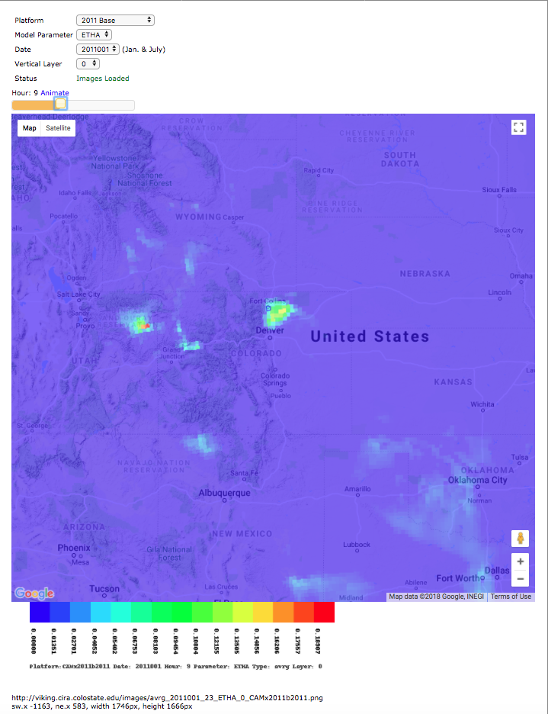
Air Quality Modeling
Modeling Data Tools
WAQS 2011b CAMx 12km, Jan. 1, ground level ethane

Slide 12
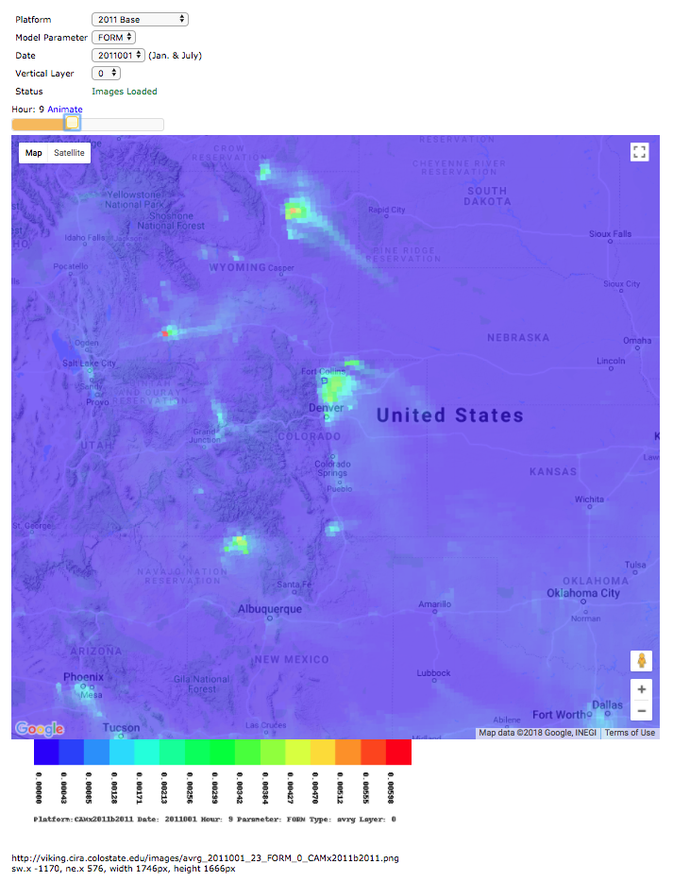
Air Quality Modeling
Modeling Data Tools
WAQS 2011b CAMx 12km, Jan. 1, ground level formaldehyde

Slide 13
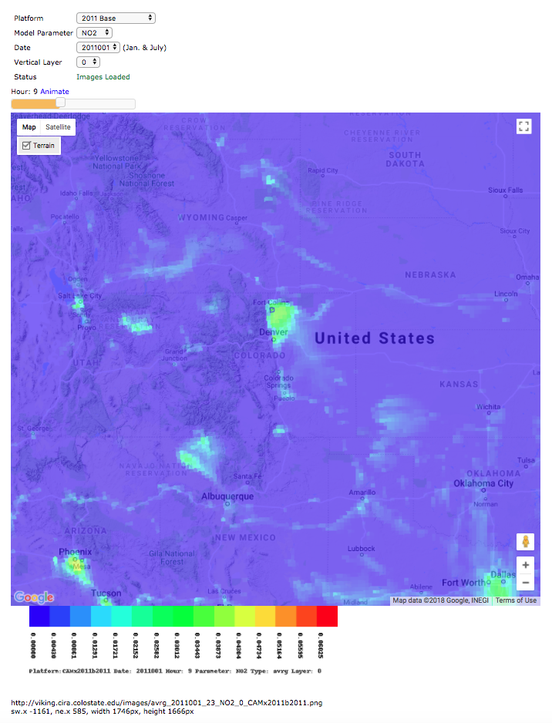
Air Quality Modeling
Modeling Data Tools
WAQS 2011b CAMx 12km, Jan. 1, ground level NO2

Slide 14
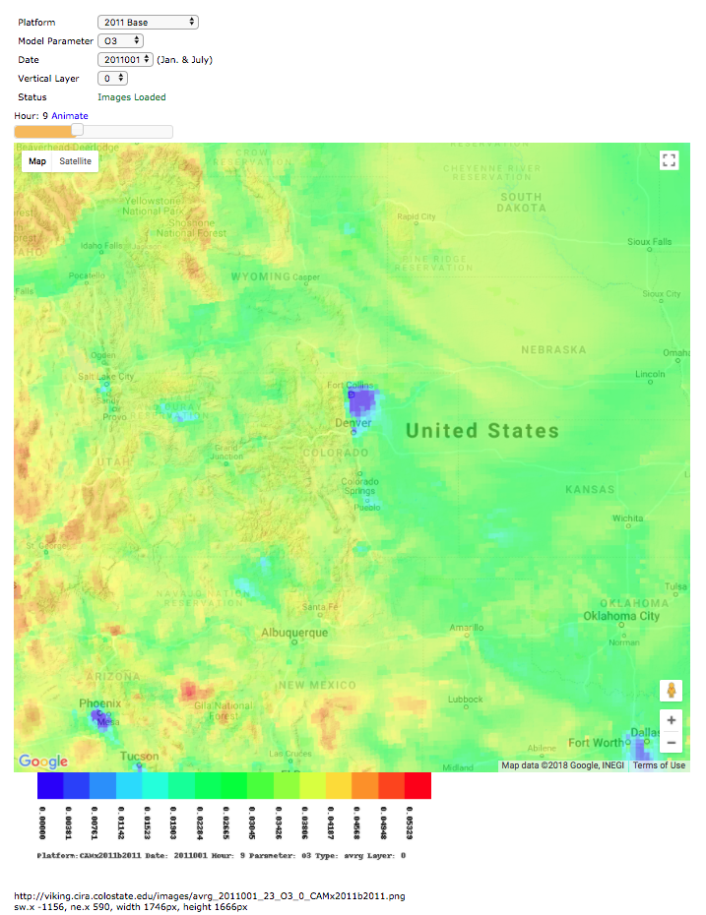
Air Quality Modeling
Modeling Data Tools
WAQS 2011b CAMx 12km, Jan. 1, ground level ozone

Slide 15
Summary
TEMPO and IWDW-WAQS Synergies
Remote Sensing Data
Provide easily accessible remotely-sensed land use/cover data
Access to “actual” remote sensing data at high spatial and temporal resolution
Monitoring data
Monitor locations/sampling frequencies
Ground truth remotely sensed data using AQ observations
Emissions Processing
Address discrepancies top-down vs. bottom-up emissions inventories
Inform development of spatial and temporal surrogates used to downscale area EIs
AQ Modeling
Compare model outputs to TEMPO data (e.g. primary and secondary AQ species)
Visualization tools for raw and processed emission and PGM outputs

Slide 16
Important Data Warehouse Links
IWDW Website:
http://views.cira.colostate.edu/tsdw/
IWDW Description and Background:
http://views.cira.colostate.edu/tsdw/About
IWDW Data and Tools:
http://views.cira.colostate.edu/tsdw/Data
IWDW Resources:
http://views.cira.colostate.edu/tsdw/Resources
IWDW Wiki:
http://vibe.cira.colostate.edu/wiki
IWDW Forums:
http://views.cira.colostate.edu/tsdw/Forum

